Slide 1


C project group 11
GDS(“高大上”) Music Player
2019年6月28日

Slide 2
Contents
Part1
Problem Statement
Part2
Analysis
Part3
Design and Assignments
Part4
Implementation
Part5
Test

Slide 3
Part1
Problem Statement

Slide 4
Problem Statement
How to…
File
Play
Display
Lyric
MUSIC PLAYER
Custom List
UI

Slide 5
Part2
Analysis
Notes:
版权声明：300套精品模板商业授权，请联系【锐旗设计】:https://9ppt.taobao.com，专业PPT老师为你解决所有PPT问题！

Slide 6
Analysis
OPEN FILE
MAKE LIST
Structure
WE
NEED
Control
Windows&API
Arrangment
LYRIC
Linke list
Notes:
版权声明：300套精品模板商业授权，请联系【锐旗设计】:https://9ppt.taobao.com，专业PPT老师为你解决所有PPT问题！

Slide 7
Part3
Design and Assignments

Slide 8
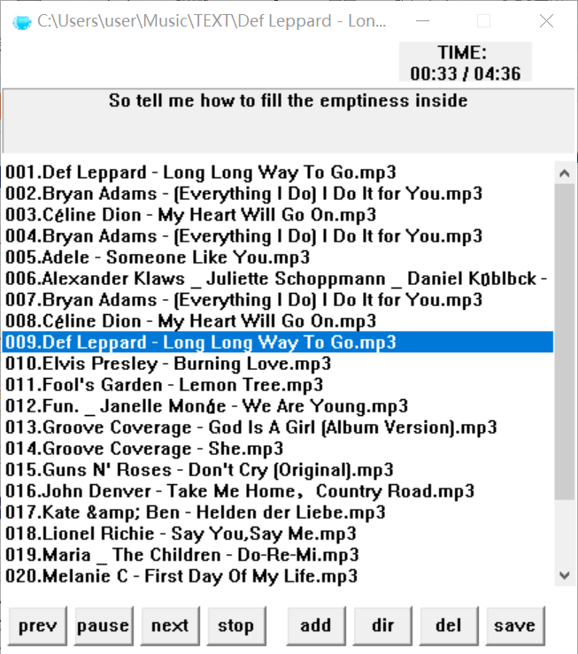
Part 3-1 Design and Assignments
Main Functions
basic func-tions
Lu
Lyric
playlist
Lin
UI
Stop
basic functions about playing, pausing, stopping and so on
functions about lyric and other things;
UI design and other things

Slide 9
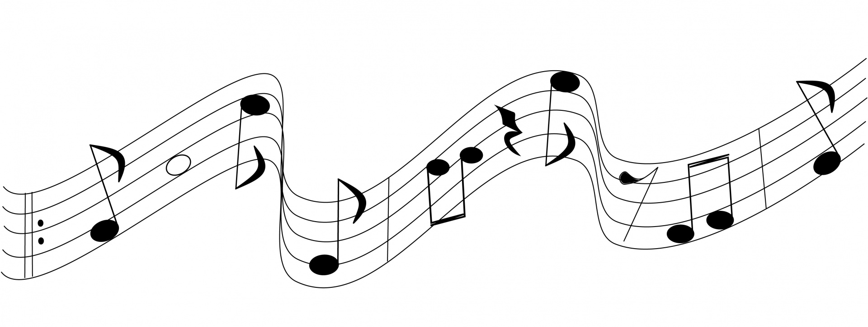
Part 3-2 Main functions of the player
Play most of songs
Tools:
C Language
windows operating system Microsoft Visual Studio 2015
Microsoft DirectX SDK.
01
02
Play / Pause / Stop
Create m3u song list
Be able to
06
03
Add / Delete songs in the List
Display lyrics
05
04
Display
Timer

Slide 10
4-1 Basic Functions
Part4
Implementation
4-2 Playlist and Lyrics
4-3 UI Design

Slide 11
4-1 Basic functions
gdsPlayFile
InitPlay :initialize the play file
Create a thread
Playthread
mpPlay1
InitPlay
control
mpPlay, mpStop, mpPause
initialize
CheckThread
Play, Stop, Pause
CheckThread: send PT_QUIT command to stop
next
DestroyPlay
DestroyPlay: release
end
We use two threads to achieve basic functions. One is Playthread, the other one is CheckThread.

Slide 12
4-2-1 Playlist and Timer
PlaylistInit
PlayListDestroy
1
2
GetItemFromDefaultPlaylist
GetDefaultPlaylistTotalItem
1
2
GetItemFromDefaultPlayList
GetDefaultPlaylistTotalItem
g_playlistitemcount
DefaultPlaylistAddItem
DefaultPlaylistDeleteItem
DefaultPlaylistSave
3
4
3
4
BeginTimeEvent
EndTimeEvent

Slide 13
4-2-2 Lyric
LyricInit
memset
strcat
Free the array of lyric
Account the number of Characters and use the memset function to free the array
Arrange the lyric by time
Analyze the time tag before the line of lyric by comparation.
Release it on the end
When not search the ‘[’,end up with the struction and release the line
Make a struct of LineLyric
Use an array to save lyric’s information including time ,char, address
Read the lyric
Delete the tag and write the lyric into the array.
Get the next one
Make the address to the next one
*GetLyricByPos
LyricDestroy
LineLyric *llnode
LineLyric *g_lineLyricHead
LineLyric *g_lineLyricTail
*GetLyricByStartTime

Slide 14
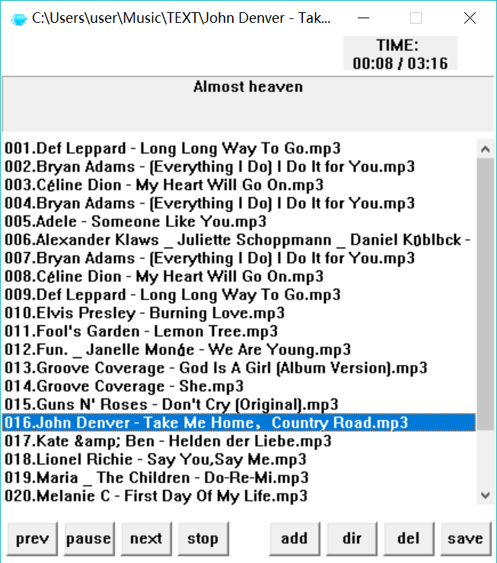
4-3 UI
WinMain
APIENTRY
WNDCLASSEX
lpfnWndProc WndProc
WM_COMMAND
LOWORD(wParam)
HIWORD(wParam)
LBN_DBLCLK
WndProc
WM_PAINT
WM_CREATE
WM_COMMAND
WM_DESTROY
WM_CREATE
WC_STATIC
WC_LISTBOX
WC_BUTTON

Slide 15
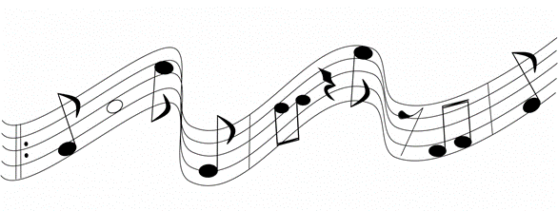
IT’S TIME TO SHOW OUR PLAYER!
Part5
Test

